Slide 1
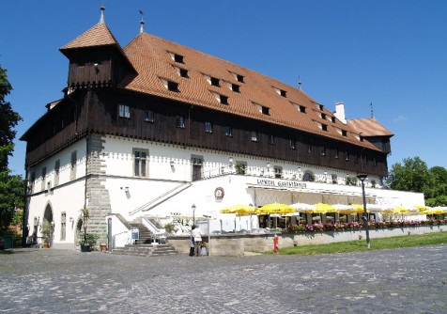
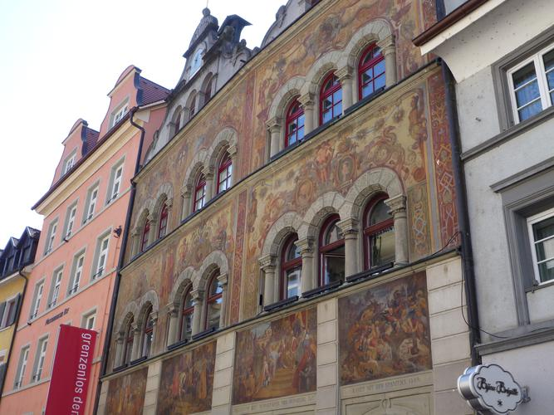
Ewg meeting
Council Building (Konzilsgebäude)
6 p.m. Start of Guided tour
Train Station
8 p.m. Town Hall reception
(Kanzleistraße)

